Slide 1
Wellbeing Census for Schools

Slide 2
What is a wellbeing census?
Wellbeing is about how well you are feeling; It can be things like how happy you are at the moment and how you get along with people around you.
A census is a survey or a list of questions that is usually carried out to understand more about the people completing it.

Slide 3
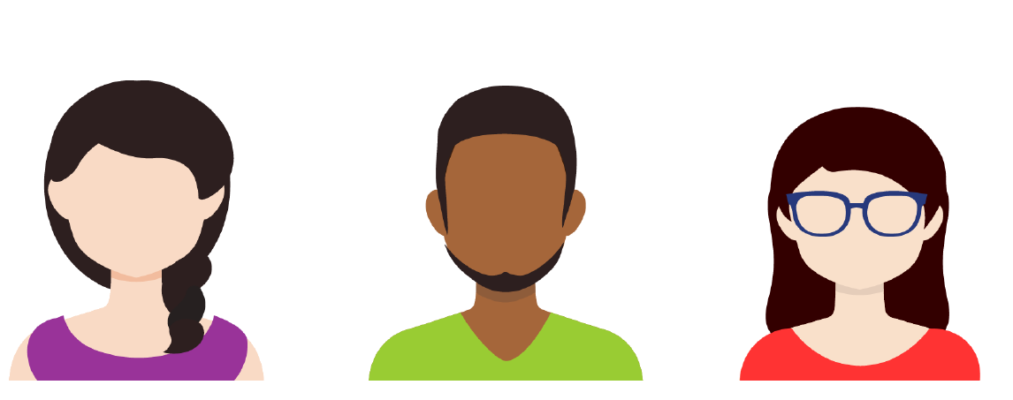
What is a wellbeing census?
In this census we are looking at your wellbeing so we can better understand more about how young people are feeling in schools. We can then try and make things better for young people like you ☺
You can help us do this by answering a short set of questions about how you are feeling at the moment. There is no right or wrong answers!!

Slide 4
Will anyone know my answers and do I have to take part?
All the answers you give will be kept private and you will not be asked for your name. Your school will share some other basic information about you and your unique pupil number. We need this information so we can link up your answers between years.
You do not have to take part and nothing will happen to you if you do not want to take part.

Slide 5
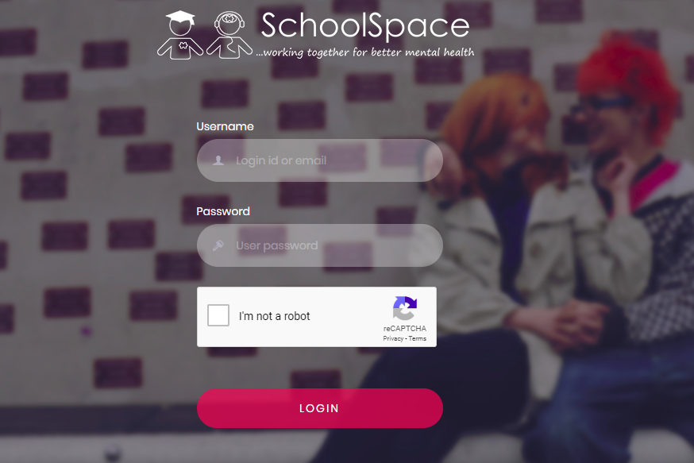
What do you need to do?
If you are ready to take part then in a moment your teacher will give you a link to click on or will give you a code you can use to login to www.breathe-schools.co.uk
Once you are logged in just click on the option after each question that says how you’ve been feeling over the last 2 weeks.
Please finish all the questions and click submit to complete the census
It only takes about 5-10 minutes ☺

Slide 6
That is it! Thank you for taking part!
If you have any other questions or are unsure about any questions then ask your teacher

